Slide 1






PocketPaw
YOUR PET IN YOUR POCKET

Slide 2
Our team
David Pérez
Federico
Falcone
Gullem
Escriba
Oriol Soler
CEO
CFO
CEO
GENERAL MANAGER
Data Science Engineer
Computer Engineer
Data Science Engineer
Audiovisual Engineer

Slide 3
PocketPaw: Pet Care All in a Single Platform
Ease of use
Whole Eco-system
Satisfaction
Innovation
Our brand is born from the necessity of contribute with a global better pet care. We launch to the market a brand-new app offering a whole eco-system with all the resource you might need for your pet

Slide 4
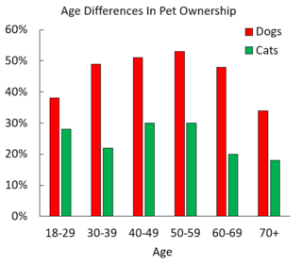
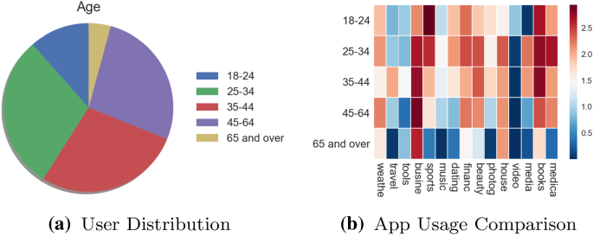
Segmentation
NO POSSIBLE AGE SEGMENTATION
OLDER PEOPLE ARE FAR AWAY
Evenly distributed by age
Our data about pet owners tell us that there is no relevant difference on the age of them, since even the people older than 70 is close to the rest of the owners, so any segmentation in this was will make the difference.
The youngest conquer the internet
Here we do see an important pattern for our segmentation. The 80% of the apps users are younger than 45 years old, which shows us that our product may be more difficult to adapt in the older section of our potential customers.

Slide 5



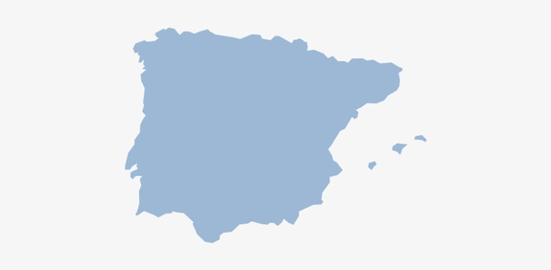

Target Market
FROM THE OPERATIVE MARKET, COMPOSED BY ALL PEOPLE OWNING A PET, WE SELECT THE PART OF THIS MARKET SET IN SPAIN, TAKING INTO ACCOUNT THE AGE BECAUSE OF THE USE OF AN APP, AND A MINIMAL BUDGET:
BUDGET
SEX
AGE
59% of spanish men have pets.
65% of spanish women have pets.
No relevant segmentation here
Pets for youngers and olders.
"The youngest conquer the internet".
Average expense of 400€/year in pets care
Our product pricing is affordable to them
BOTH
<45
€ € €

Slide 6



Competitors
PET CARING
11pets
Offer 4 different types of services, the most similar being 11pets: Pet Care.
They offer a portal for storing and consulting pet personal data, vet appointments, etc.
DOG TRAINING
Puppr
Services: Easy Video Instructions, 100+ Lessons, Live Chat with Trainers, etc.
DOG GPS TRACKER
Offer two plans (basic and PRO):
Services: Regular location updating, Live tracking Unlimited, Activity and Sleep, SHARE WITH FAMILY, WORLDWIDE RANGE, UBICATION HISTORY, DATA EXPORT.
Tractive

Slide 7

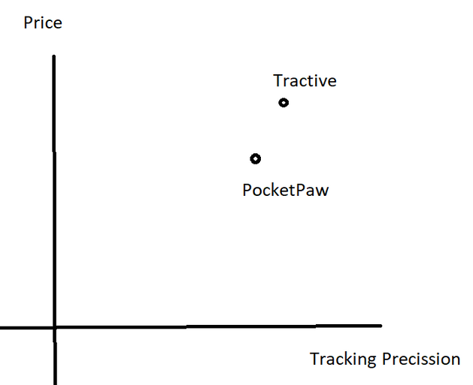
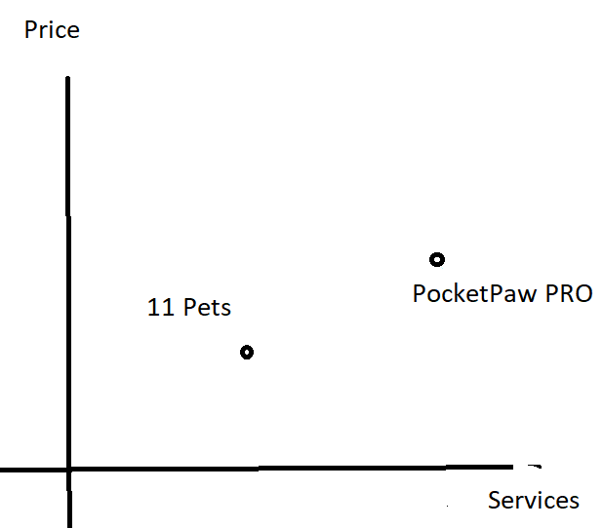
Positioning
Our application offer an all-in-one platform for every pet care. The main factors for which the potential clients show the most interest in are based on the tracking device & service and the amount and quality of total services offered. For those:
TRACKING DEVICES
TOTAL SERVICES VALUE

Slide 8
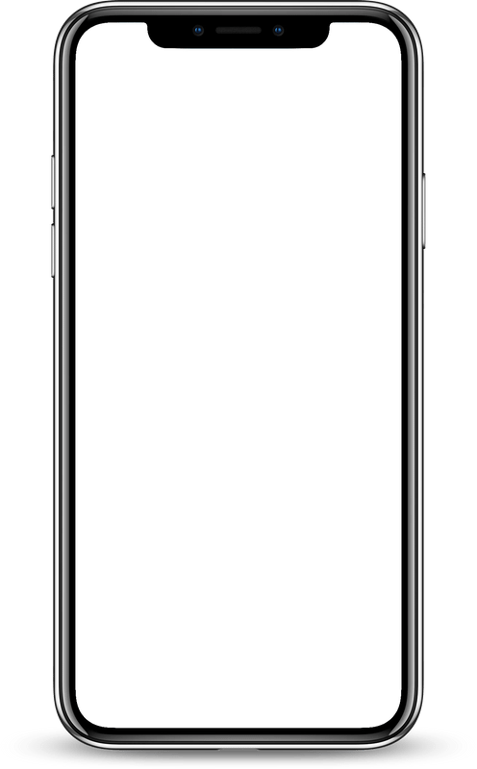














PocketPaw App
Activity
Tracking
Pet profile
Pet tracking results:
HOME PAGE:
Select a location to obtain more information about it.
Here we can see the main features of the app:
Activity tracking
Pet Profile
Reminders and schedulers
GPS tracking
Medical records
Social community
Reminders and schedules
GPS tracking
PRO
PET TRACKING MAP:
Medical records
Social community
An interactive map that tracks the current location of each of our registered pets to know at real time where are they.
List of tracked pets:
List of tracked pets:
PRO
PRO

Slide 9





POCKETPAW SERVICES
PocketPaw Version
Basic
PRO
Free
With ads
Activity tracking
Reminders and medication schedules
Pet profile creation
Specialist Guides and Tips
GPS tracking
Vet affiliation and scheduling
Social community
Medical records

Slide 10

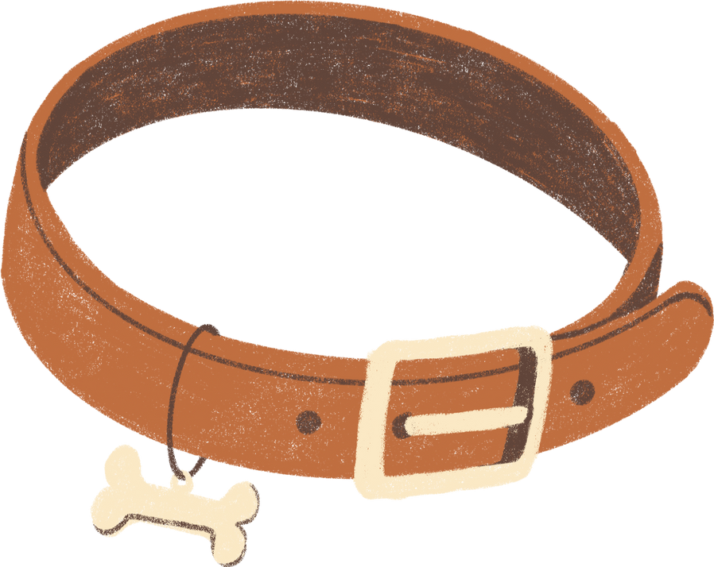
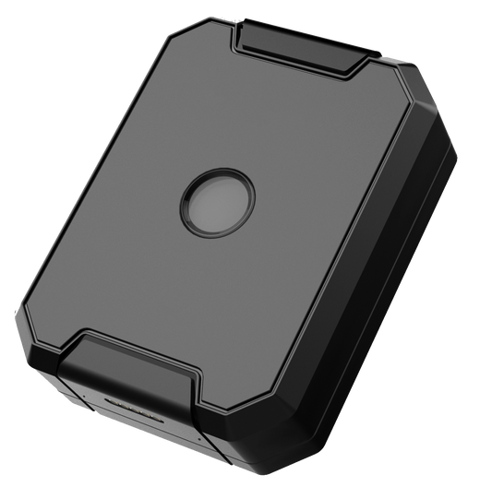
Our products
GPS DEVICE
The GPS device will be available for purchase for €25 from our official portal or from partner retailers. In case you want to buy more than one, 2 are available for €45 (10% saving) and 3 for €60 (20% saving)
ACCESSORIES
We provide our customers with a range of accessories a signed PocketPaw, such as GPS device-compatible collars
SMART DEVICES
Our catalog also features smart devices that will assist you in caring for your pet. First among them is our smart food/water dispenser that can be fully controlled remotely through our app, available for a one-time purchase of €95

Slide 11
PRO
PRO
BASIC
MONTHLY
YEARLY
Activity tracking
Reminders and medication schedules
Pet profile creation
Customer care and assistance
All the previous benefits
GPS tracking service
Specialist guides and tips
Vet affiliation and scheduling
Medical records
All the previous benefits
17% discount from the monthly plan
FREE
€4.95/MONTH
€49.95/YEAR

Slide 12
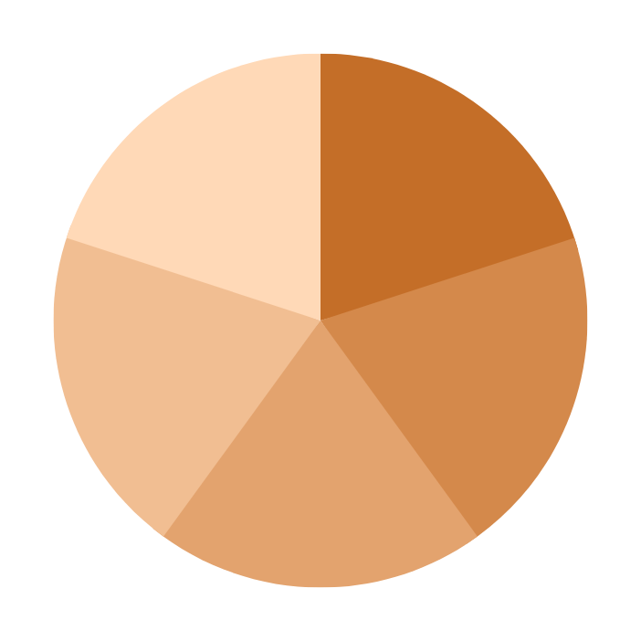




Promotion channels
Social advertising
Influencer marketing
Sponsorships
Educational content
Mail marketing

Slide 13




PocketPaw Placement
PocketPaw Products:
Future:
PocketPaw APP:
Our products can be obtained in the well-known pet shops KIWOKO with physical and online stores.
To enter the market to a more international market we have planned to collaborate with pet valu, one of the biggest distributors of North America.
PocketPaw app is available at the most important app stores:
+140
+500
stores
stores

Slide 14

Thanks for your participation!
EMAIL | WEBSITE | SOCIALS
info@pocketpaw.com | www.pocketpaw.com | @pocketpaw

